Slide 1

Weka

Slide 2
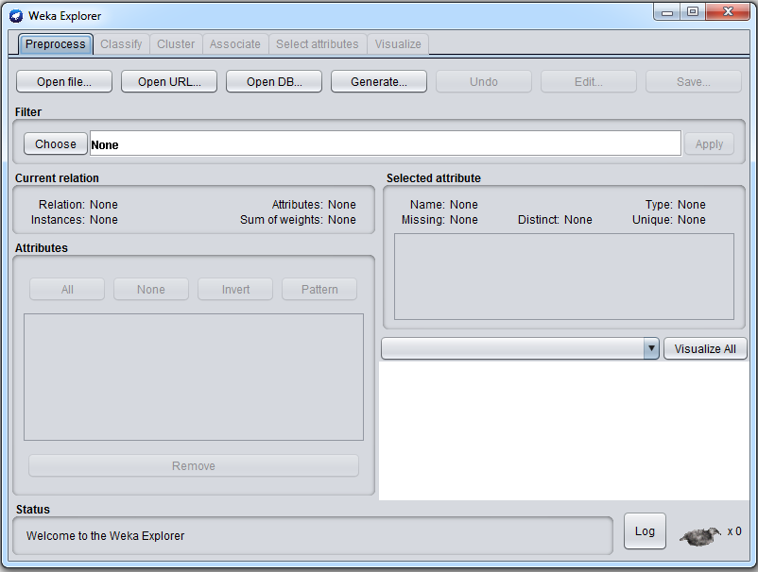
Preprocessing

Slide 3
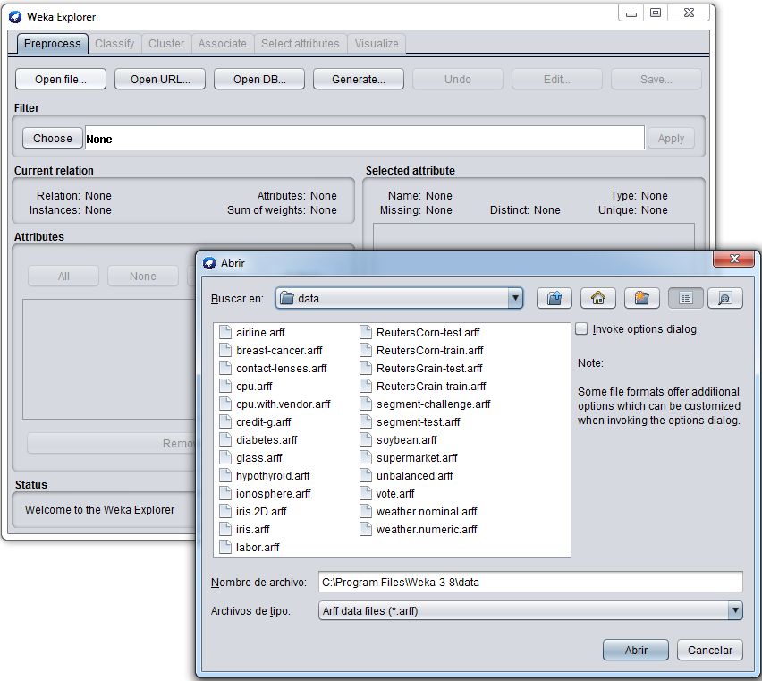
Opening a file

Slide 4
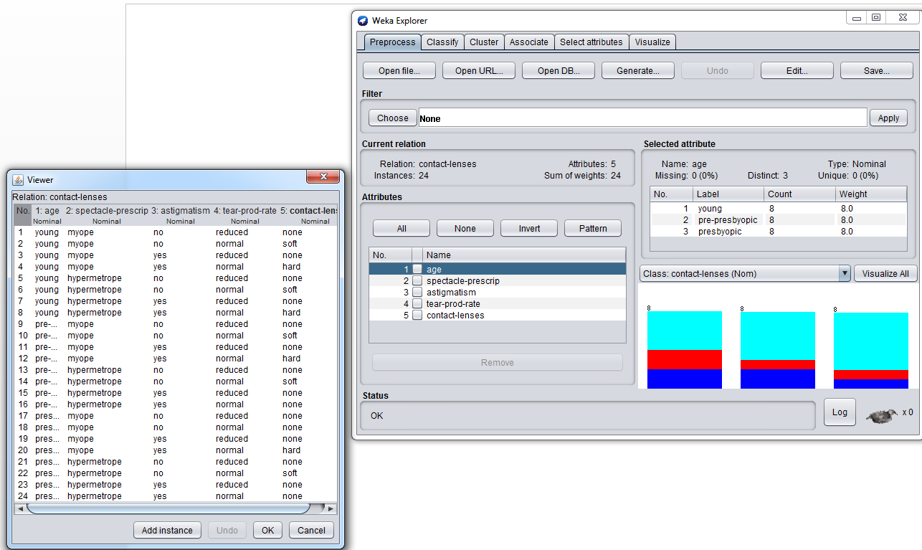
Editing a file
Visualize a variable

Slide 5
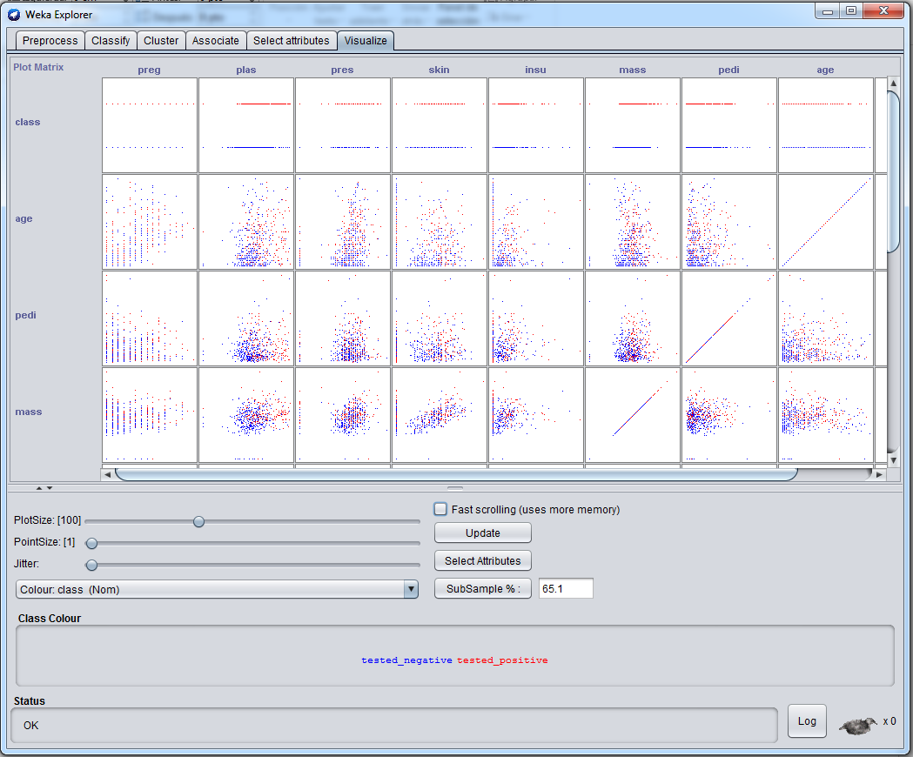
Visualizing pairs of variables

Slide 6
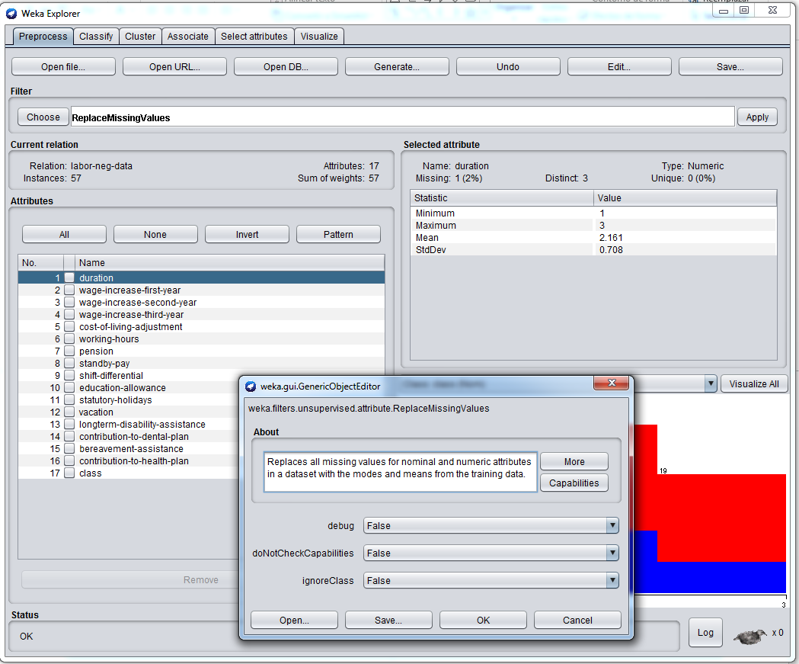
Missing values

Slide 7
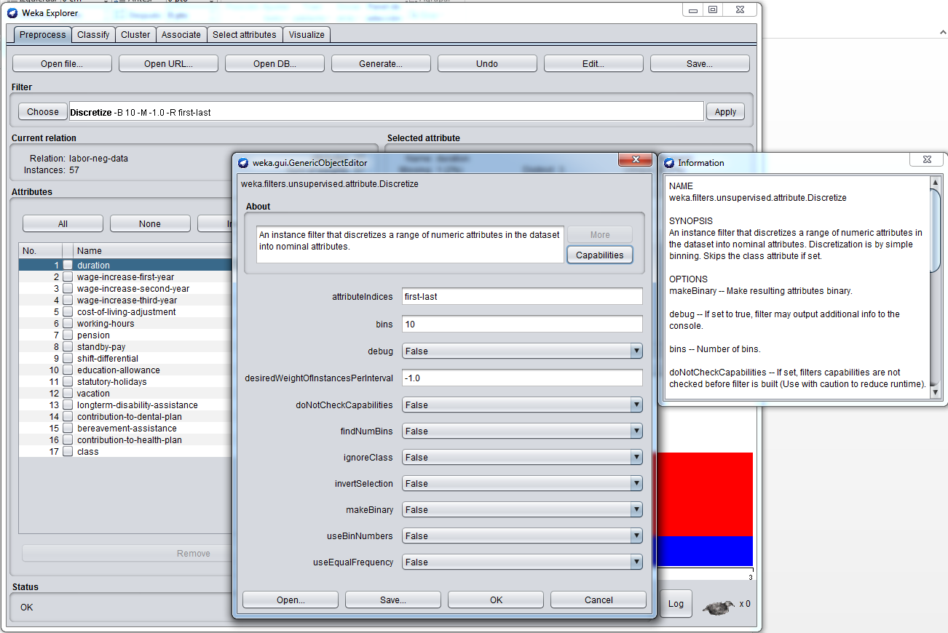
Discretizing with equal-width bins

Slide 8
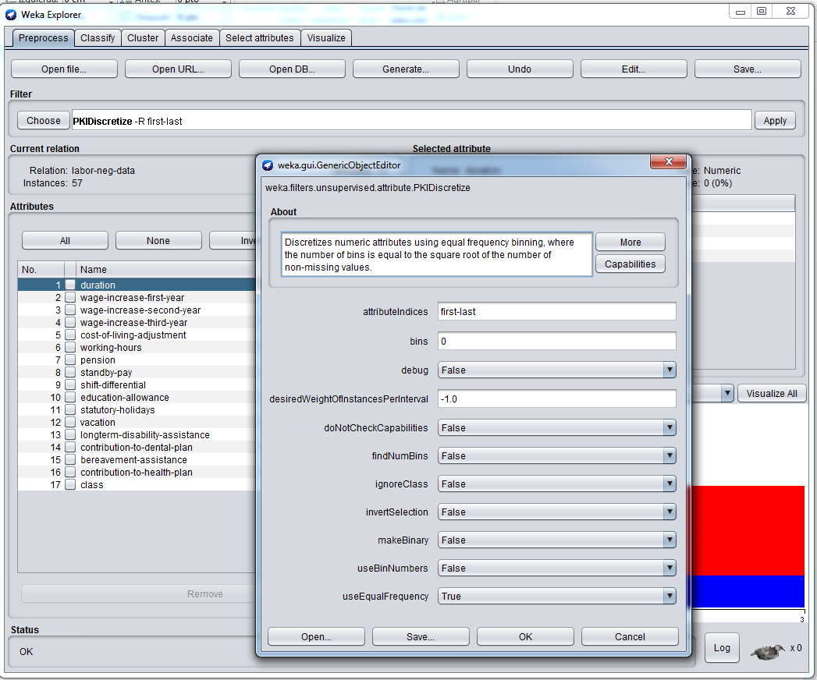
Proportional k-interval discretization

Slide 9
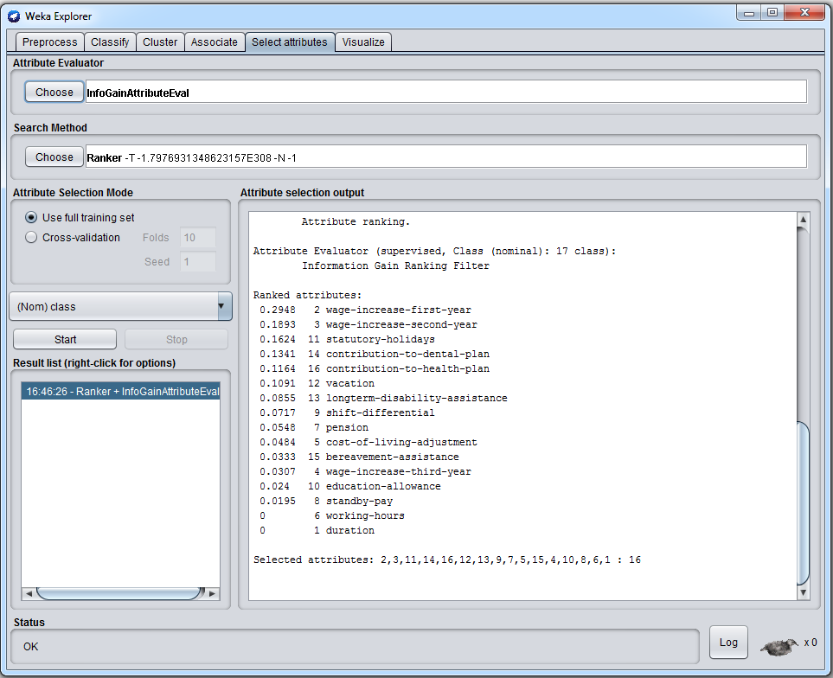
FSS: ranking variables with mutual information

Slide 10
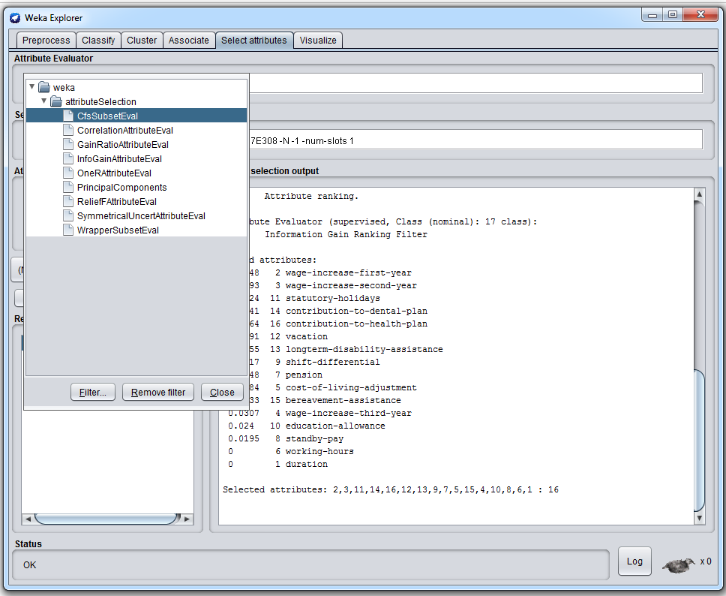
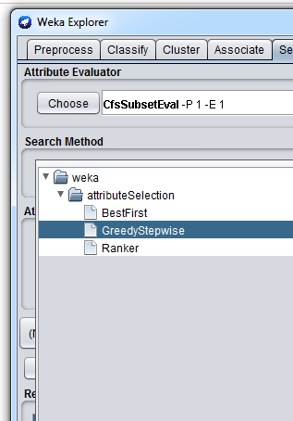
FSS

Slide 11
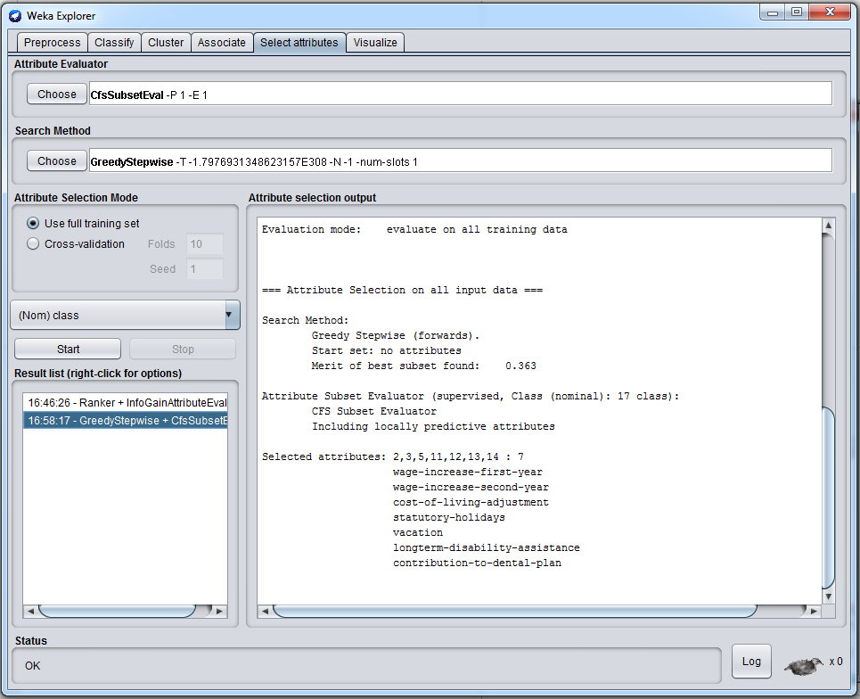
Filter FSS: CFS

Slide 12
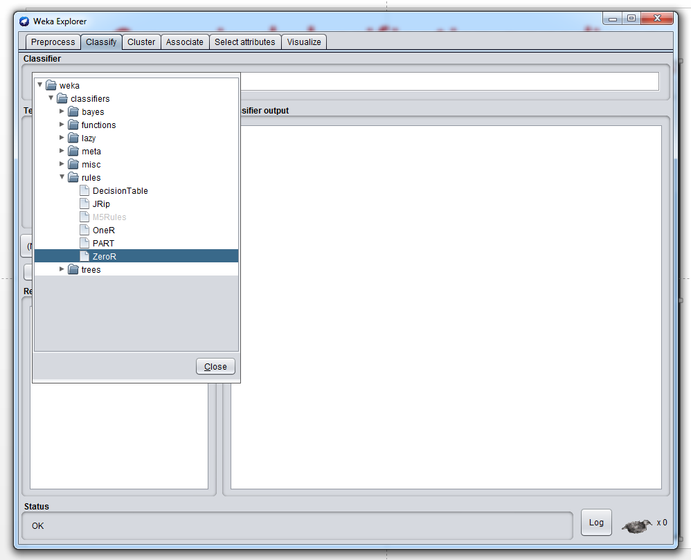
Supervised classification paradigms

Slide 13
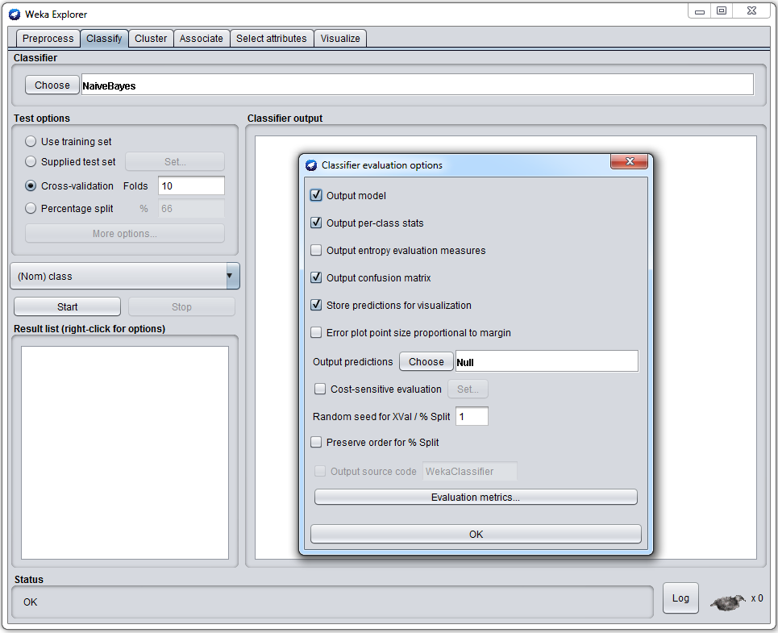
Assessing performance

Slide 14
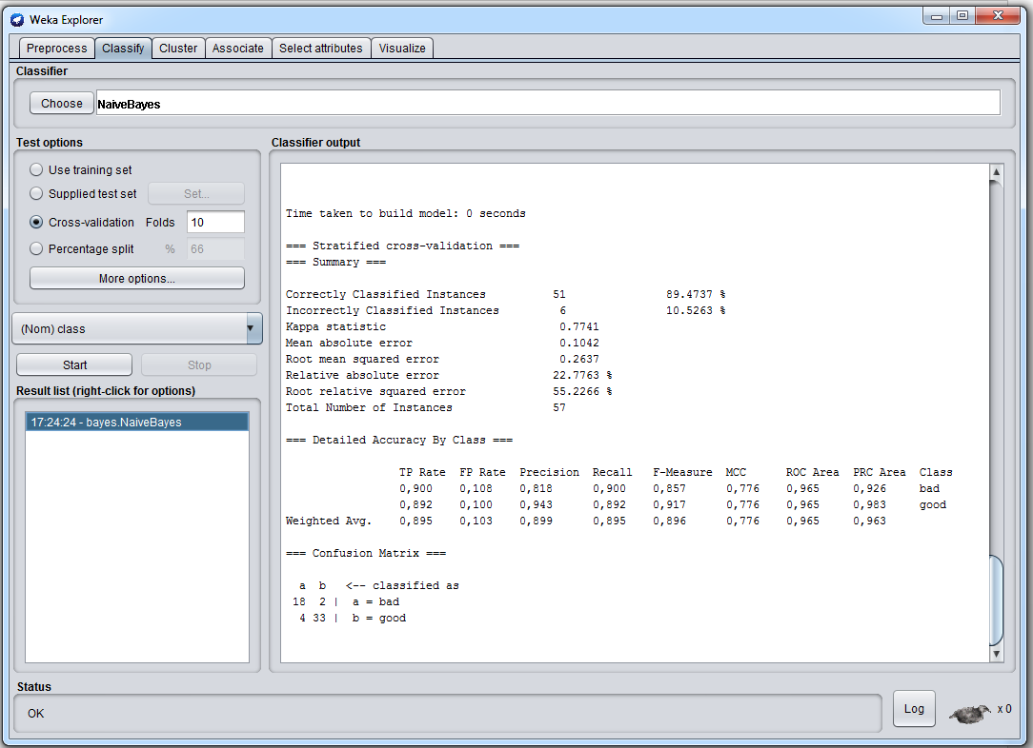
Assessing performance

Slide 15
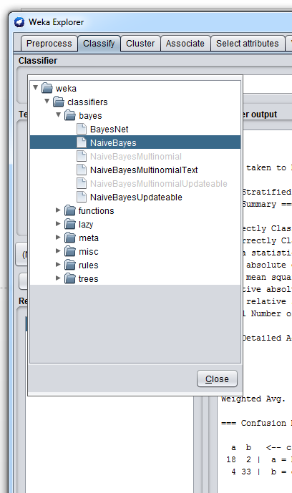
Bayesian classifiers

Slide 16
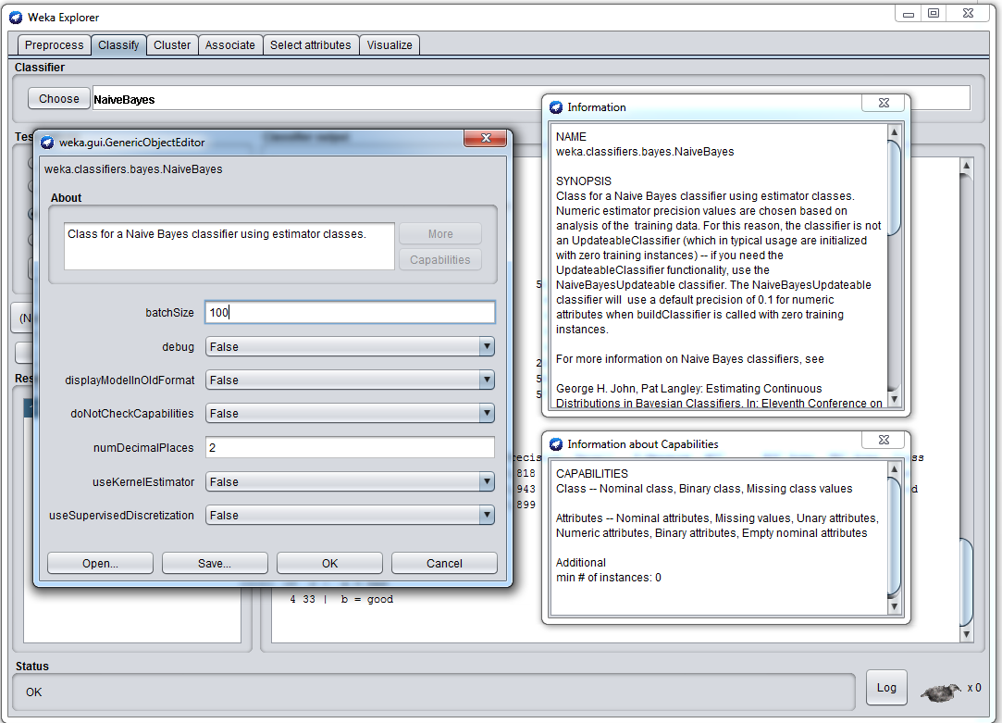
Naive Bayes

Slide 17
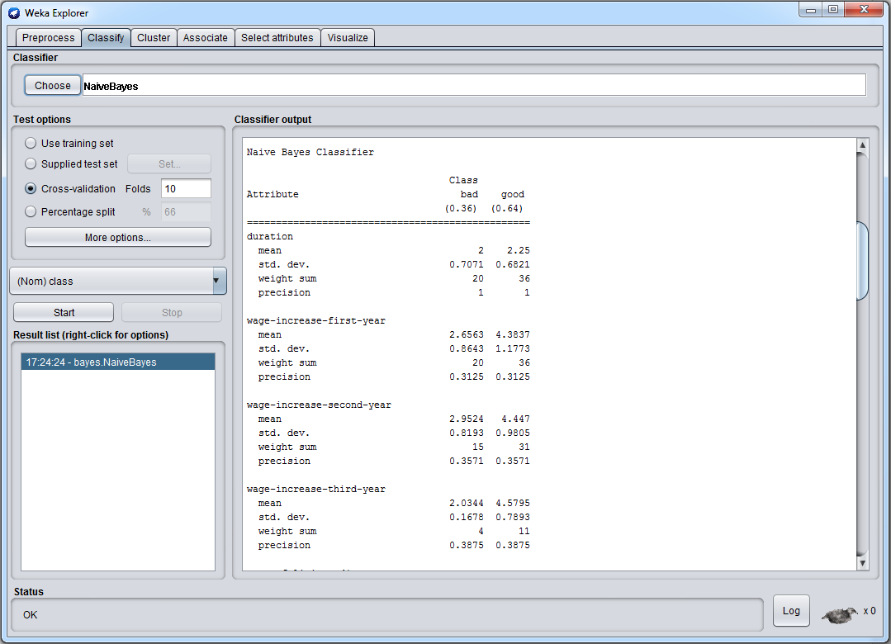
Naive Bayes

Slide 18
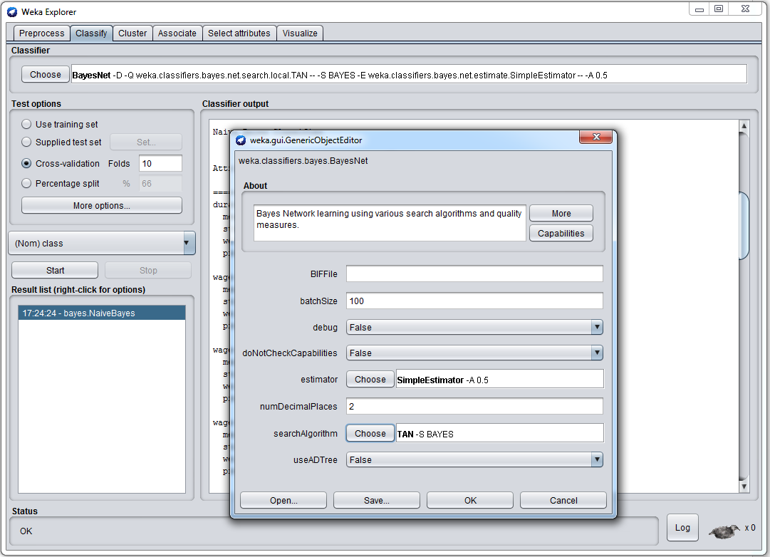
TAN

Slide 19
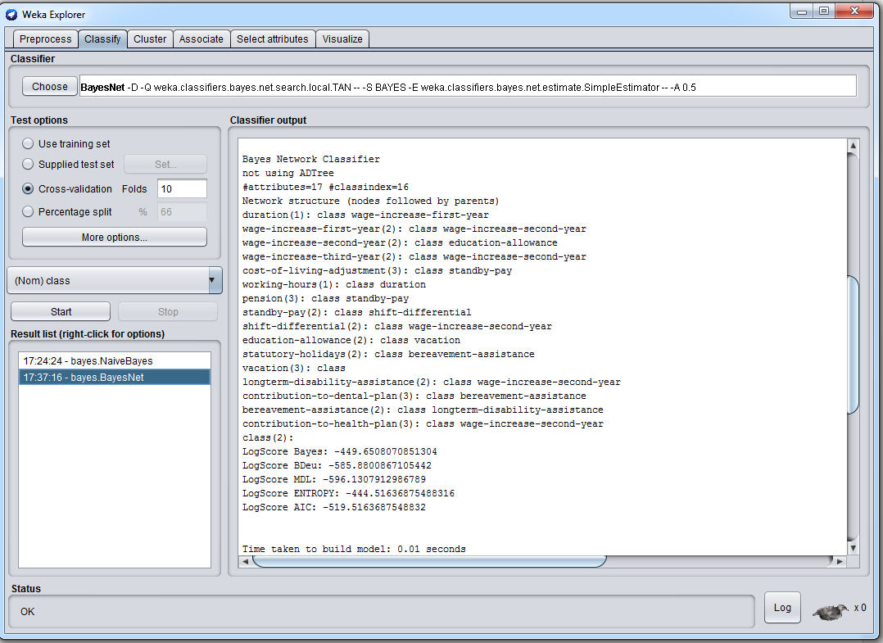
TAN

Slide 20
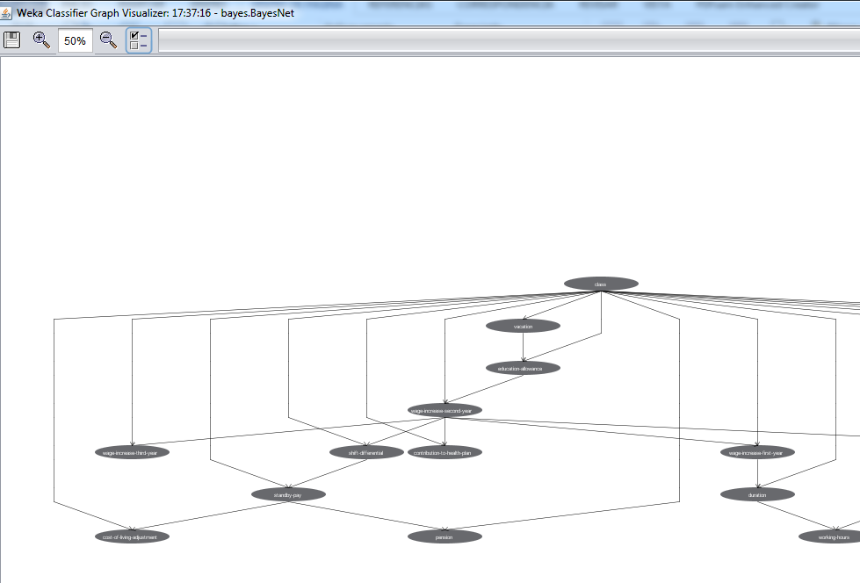
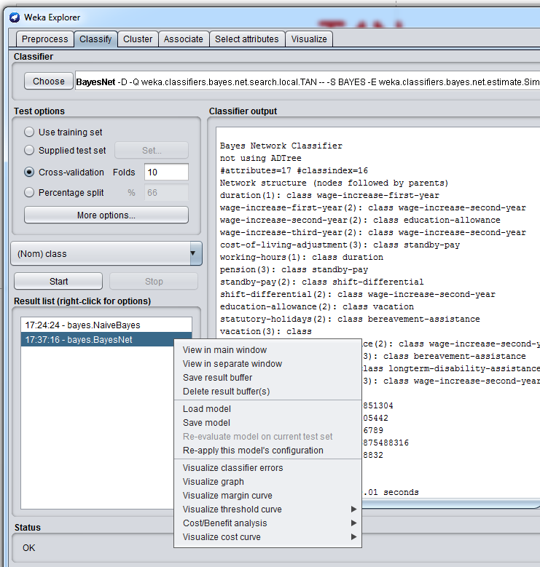
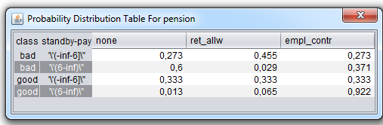
TAN

Slide 21

K-NN = Lazy

Slide 22
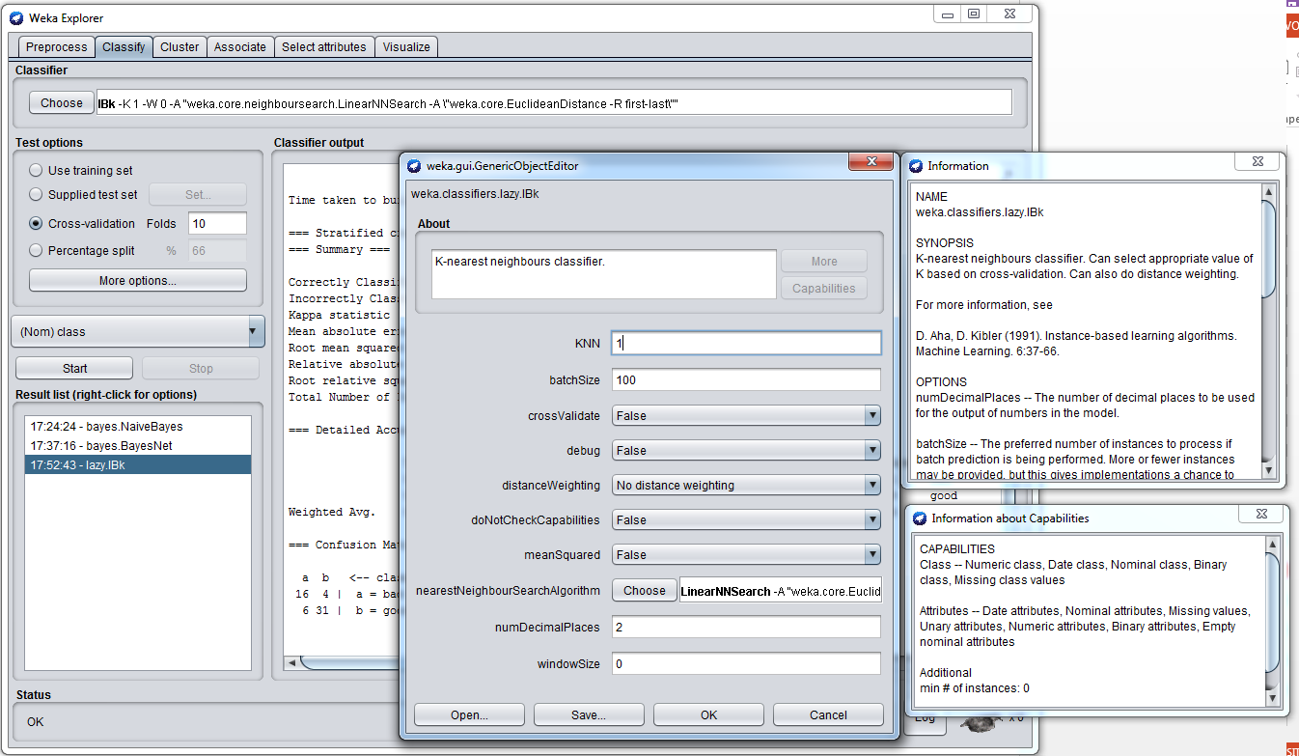
IBk

Slide 23
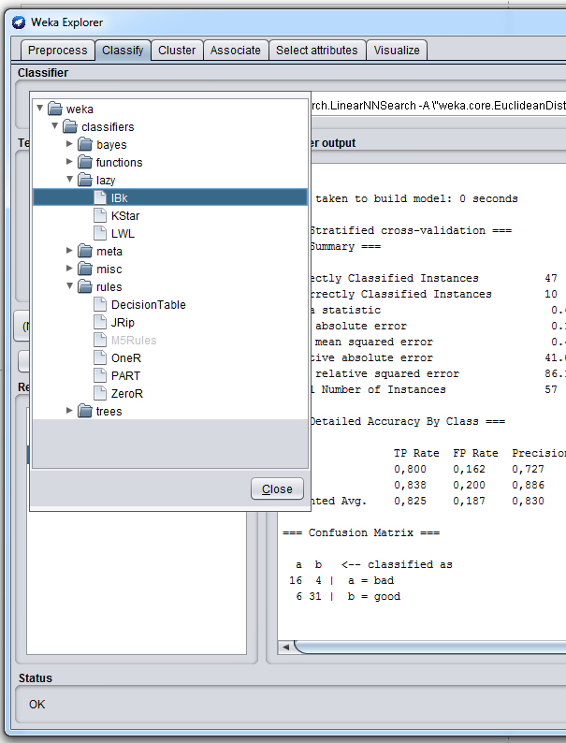
Rule induction

Slide 24
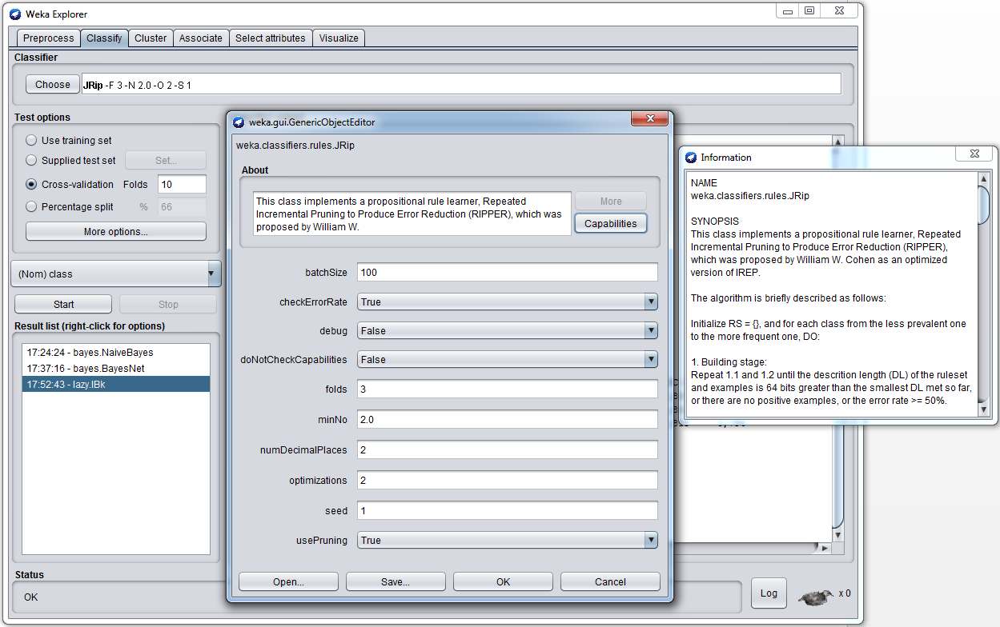
RIPPER

Slide 25
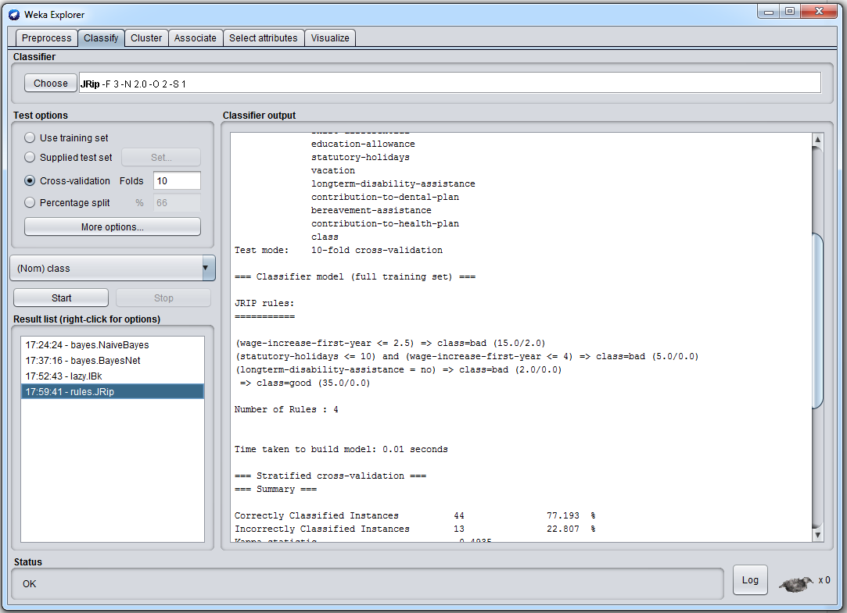
RIPPER

Slide 26
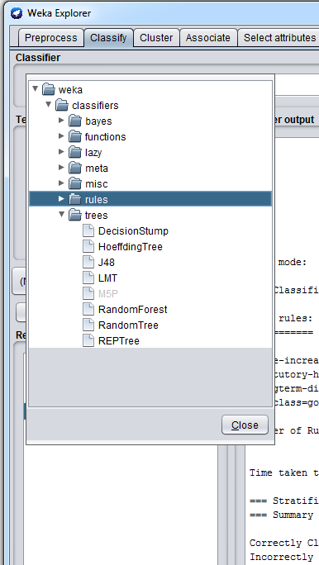
Classification trees: J48 (C4.5)

Slide 27
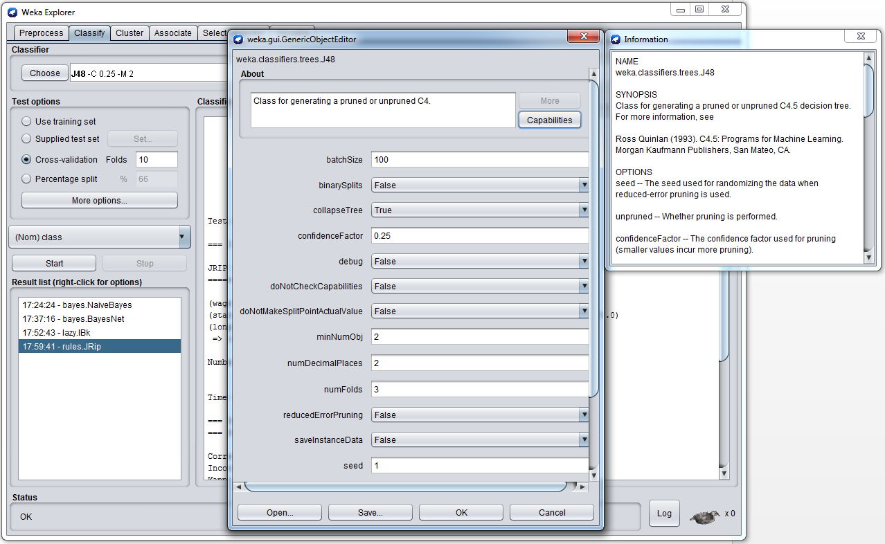
J48 (C4.5)

Slide 28
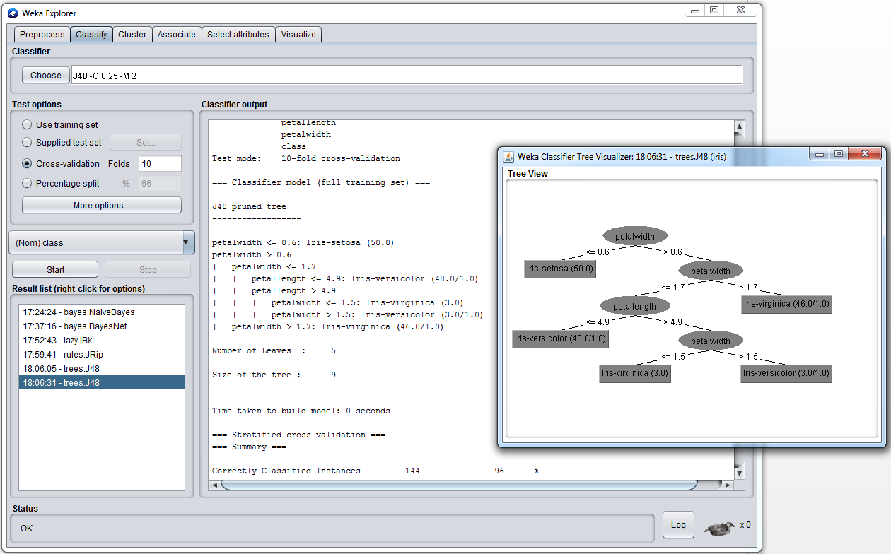
J48 (C4.5)

Slide 29
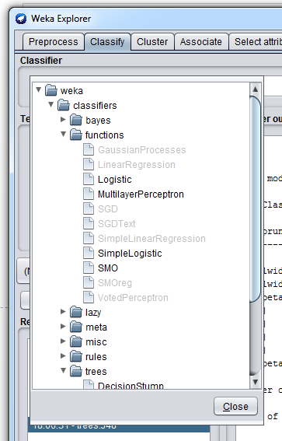
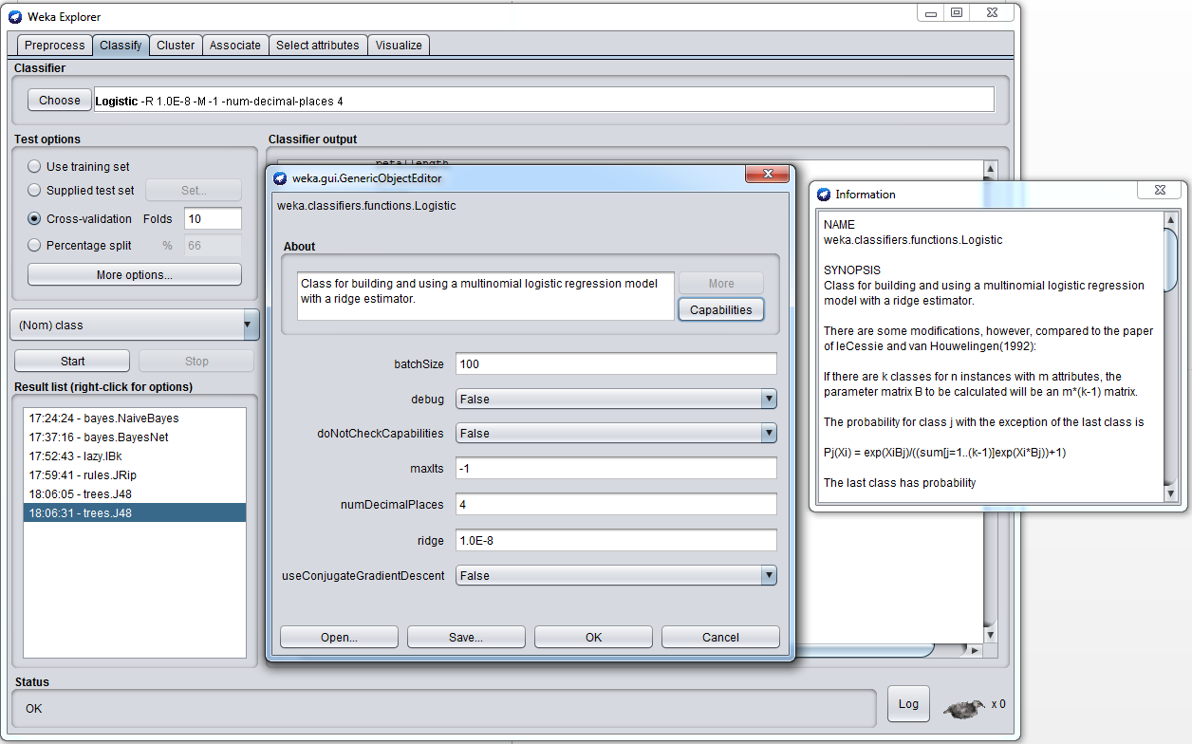
Logistic regression

Slide 30
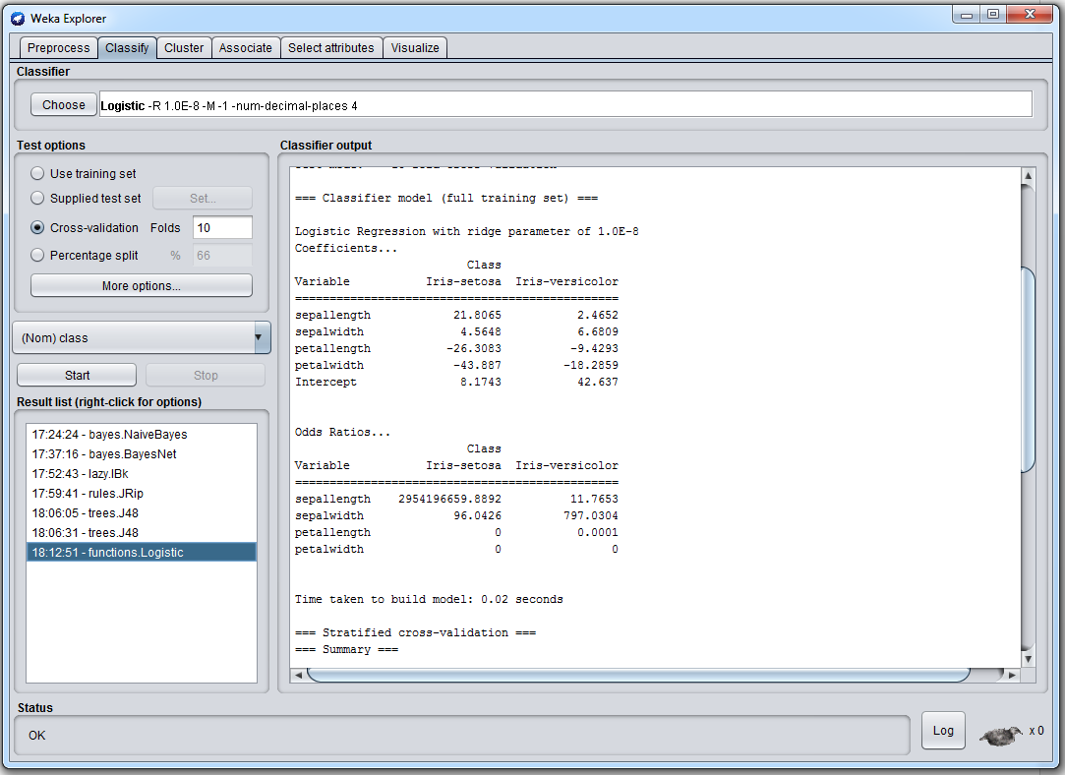
Logistic regression

Slide 31
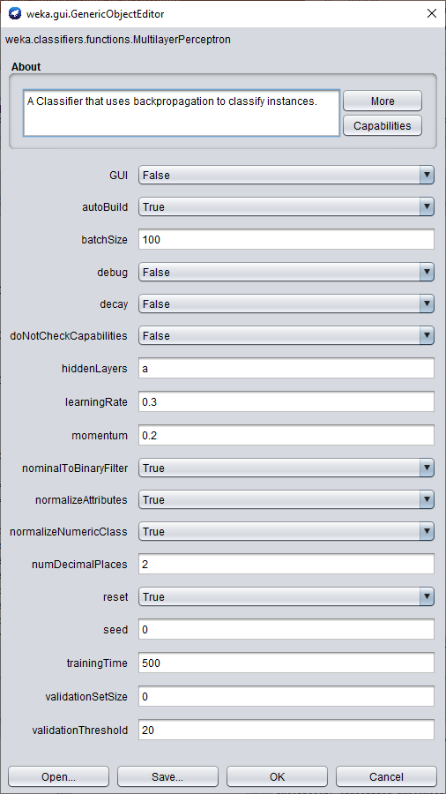
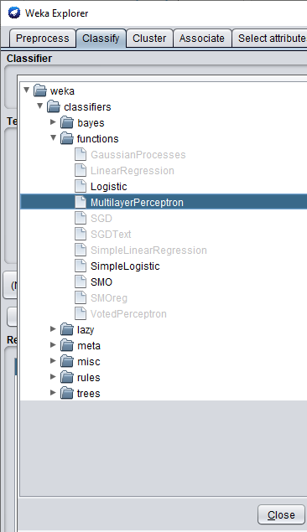
Neural Network

Slide 32
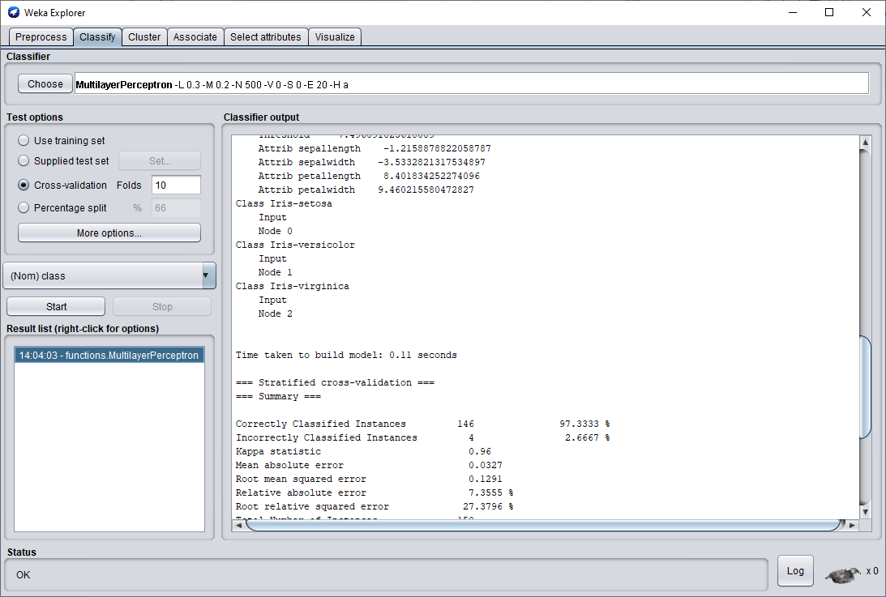
Neural Network

Slide 33
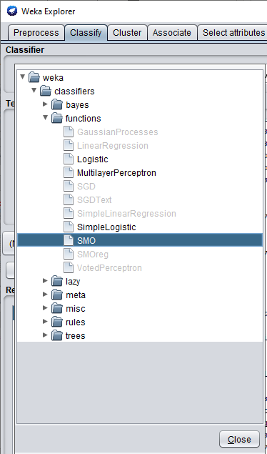
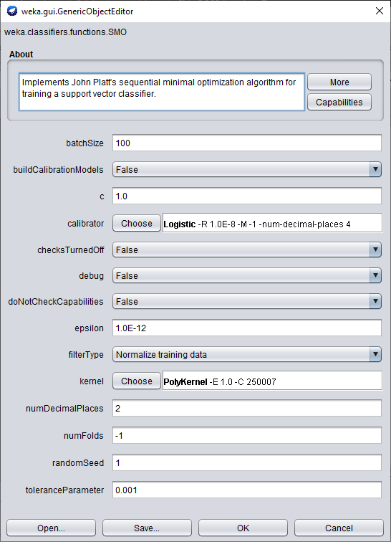
SVM

Slide 34
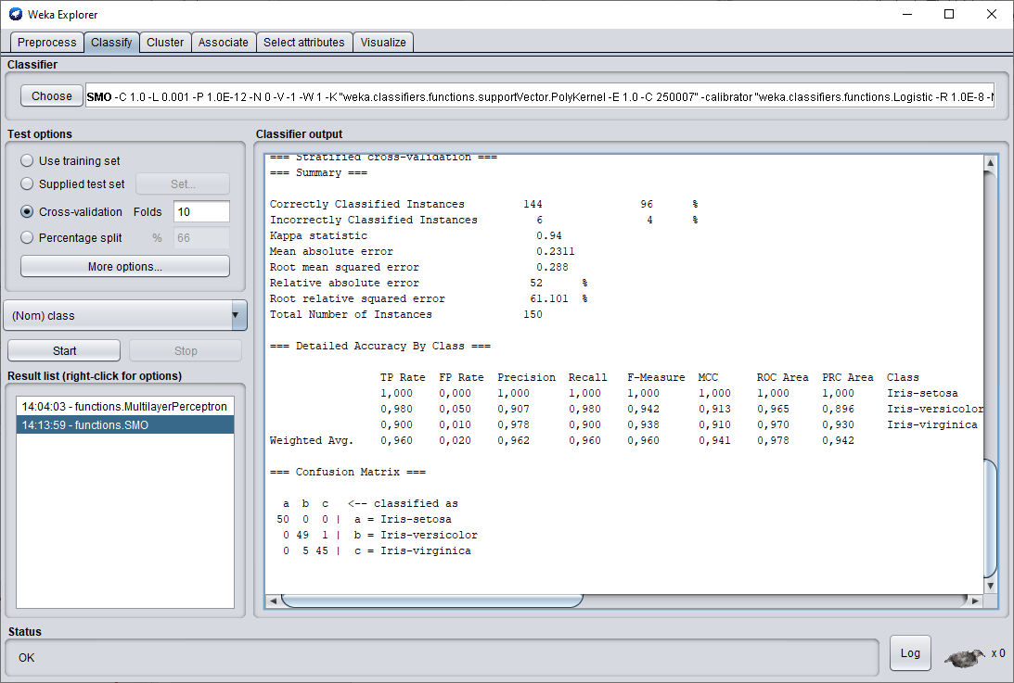
SVM

Slide 35

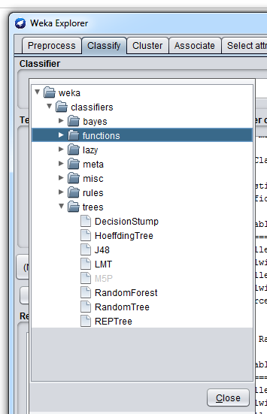
Combining classifiers

Slide 36
Exercise
All variables FSS1 FSS2
Naive Bayes
TAN
IB1
IBk
RIPPER
C4.5
Logistic

Slide 37
Exercise
All variables FSS1 FSS2
AdaBoostM1
Bagging
Stacking
Vote
LMT
RandomForest

